Slide 1
Workshop
Introducing Windows Server and Hyper-V Containers
Technical Preview 5
Speaker| @twitter

Slide 2
Module Agenda
Getting started with Containers.
Integrating with Docker.
Development with Containers.
Microsoft’s Container runtimes.
Labs

Slide 3
Getting started with Containers.

Slide 4
Containers A new approach to build, ship, deploy, and instantiate applications
}
Applications traditionally built and deployed onto physical systems with 1:1 relationship
New applications often required new physical systems for isolation of resources
}
Package and run apps within
Containers
Physical
}
Physical/Virtual
Higher consolidation ratios and better utilization
Faster app deployment than in a traditional, physical environment
Apps deployed into VMs with high compatibility success
Apps benefited from key VM features i.e. Live migration, HA
Key Benefits
Further accelerate of app deployment
Reduce effort to deploy apps
Streamline development and testing
Lower costs associated with app deployment
Increase server consolidation
Virtual

Slide 5
Why Containers? Applications are fueling innovation in today’s cloud-mobile world
Containers unlock ultimate productivity and freedom
Enable ‘write-once, run-anywhere’ apps
Can be deployed as multi-tier distributed apps in IaaS/PaaS models
Containers offers powerful abstraction for microservices
DevOps
Developers
Enhances familiar IT deployment models
Provide standardized environments for development, QA, and production teams
Abstract differences in OS distributions and underlying infrastructure
Higher utilization and compute density
Rapid scale-up and scale-down in response to changing business needs
Integrate people, process, and tools for an optimized app development process
Operations focus on standardized infrastructure
Developers focus on building, deploying and testing apps
Operations

Slide 6
Containers Isolated runtime environment for hosted applications
}
Container
Dependencies: Every application has it’s own dependencies which includes both software (services, libraries) and hardware (CPU, memory, storage).
Virtualization: Container engine is a light weight virtualization mechanism which isolates these dependencies per each application by packaging them into virtual containers.
Shared host OS: Container runs as an isolated process in user space on the host OS, sharing the kernel with other containers.
Flexible: Differences in underlying OS and infrastructure are abstracted away, streamlining ‘deploy anywhere’ approach.
Fast: Containers can be created almost instantly, enabling rapid scale-up and scale-down in response to changes in demand.
App A Bins/Libraries
App B Bins/Libraries
Container Management Stack
Host OS w/ Container Support
Server

Slide 7
Containers How do they differ from virtual machines?
}
Virtual Machine
Dependencies: Each virtualized app includes the app itself, required binaries and libraries and a guest OS, which may consist of multiple GB of data.
Independent OS: Each VM can have a different OS from other VMs, along with a different OS to the host itself.
Flexible: VMs can be migrated to other hosts to balance resource usage and for host maintenance, without downtime.
Secure: High levels of resource and security isolation for key virtualized workloads.
App A Bins/Libraries
App B Bins/Libraries
Guest OS
Guest OS
Hypervisor
Server

Slide 8
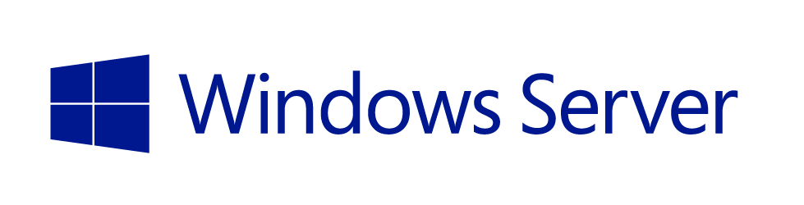



Container Ecosystem
Container Run-Time
Container Images
Image Repository
Applications
Linux
Application
Frameworks

Slide 9



Container Run-time
Operating
System
Image
Physical Host

Slide 10

Container Run-time
Host Operating System
Operating
System
Operating
System
Image
Virtual machine(s)
Hardware Virtualization

Slide 11

Container Run-time
Containers
Host Operating System

Slide 12
Container Run-time
Containers
Guest Operating
System
Image
Host Operating System
Virtual machine(s)
Hardware Virtualization

Slide 13
Demo.
Setting up a Windows Server Container host

Slide 14


Image Creation
Local Repository
Container View
Container OS
Image
C:\Windows\*

Slide 15

Image Creation
Local Repository
Container View
Sandbox
empty
C:\Windows\*
Container OS
Image
C:\Windows\*

Slide 16
Image Creation
C:\nodeJS
Local Repository
Container View
Sandbox
empty
C:\Windows\*
Container OS
Image
C:\Windows\*

Slide 17
Image Creation
C:\nodeJS
Local Repository
Container View
Sandbox
C:\nodeJs
C:\Windows\*
C:\nodeJS
Container OS
Image
C:\Windows\*

Slide 18
Image Creation
Local Repository
Container View
Sandbox
C:\nodeJs
Container OS
Image
C:\Windows\*

Slide 19
Image Creation
Local Repository
Container View
Application
Framework
Application
Framework
C:\nodeJs
Container OS
Image
C:\Windows\*

Slide 20
Image Creation
Local Repository
Sandbox
Empty
Container View
Application
Framework
Application
Framework
C:\nodeJs
C:\Windows\*
C:\nodeJS
Container OS
Image
C:\Windows\*

Slide 21
Image Creation
C:\myApp
Local Repository
Sandbox
Empty
Container View
Application
Framework
Application
Framework
C:\nodeJs
C:\Windows\*
C:\nodeJS
Container OS
Image
C:\Windows\*

Slide 22
Image Creation
C:\myApp
Local Repository
Sandbox
C:\myApp
Container View
Application
Framework
Application
Framework
C:\nodeJs
C:\Windows\*
C:\nodeJS
C:\myApp
Container OS
Image
C:\Windows\*

Slide 23
Image Creation
Local Repository
Sandbox
C:\myApp
Container View
Application
Framework
Application
Framework
C:\nodeJs
Container OS
Image
C:\Windows\*

Slide 24
Image Creation
Local Repository
Application
Image
C:\myApp
Container View
Application
Framework
Application
Framework
C:\nodeJs
Container OS
Image
C:\Windows\*

Slide 25
Demo.
Windows Server Containers and PowerShell

Slide 26
Integrating with Docker.

Slide 27


Docker integration Joint strategic investments to drive containers forward
Docker: An open source engine that automates the deployment of any application as a portable, self-sufficient container that can run almost anywhere.
Partnership: Enable the Docker client to manage multi-container applications using both Linux and Windows containers, regardless of the hosting environment or cloud provider.
Customer
Datacenter
Dockerized app
Windows Server
Container
Linux Container
Run anywhere
Microsoft
Azure
Service
Provider
Docker
}
Strategic investments
Investments in Windows Server 2016
Open source development of the Docker Engine for Windows Server
Azure support for the Docker Open Orchestration APIs
Federation of Docker Hub images into the Azure Gallery and Portal

Slide 28
Docker integration Joint strategic investments to drive containers forward
Docker Hub: Huge collection of open and curated applications available for download. https://hub.docker.com
Collaboration: Bring Windows Server containers to the Docker ecosystem to expand the reach of both developer communities.
Docker Engine: Docker Engine for Windows Server containers will be developed under the Docker open source project.
Docker client: Windows customers will be able to use the same standard Docker client and interface on multiple development environments.
Docker.exe
Examples:
docker run
docker images
Docker Client
Windows Server
Linux
Docker Remote API
Examples:
GET images/json
POST containers/create
Docker Engine
(Daemon)
Docker Engine
(Daemon)
Windows Server
Container Support
Linux Container
Support (LXC)

Slide 29
Demo.
Windows Server Containers and Docker

Slide 30
Development with Containers.

Slide 31



Development Process Using Containers
Central Repository
Local Repository
Central Repository
Application
Framework
Application
Framework
Application
Framework

Slide 32
Development Process Using Containers
Central Repository
Local Repository
Central Repository
Application
Framework
Application
Framework
Developers can choose desired application frameworks
and pull them locally from central repositories
Application
Framework
Application
Framework

Slide 33
Development Process Using Containers
Central Repository
Local Repository
Central Repository
Application
Framework
Application
Framework
Developers can choose desired application frameworks
and pull them locally from central repositories
Application
Framework
Application
Framework
Required dependencies
are automatically identified and pulled locally

Slide 34

Development Process Using Containers
using System;
class Program
{
static void Main()
{
}
}
Central Repository
Local Repository
Developers use the same programming languages and environments they are accustomed to
Central Repository
Application
Framework
Application
Framework
Application
Framework
Application
Framework

Slide 35


Development Process Using Containers
using System;
class Program
{
static void Main()
{
}
}
Central Repository
Local Repository
Central Repository
Application
Framework
Application
Framework
Application
Framework
Application
Framework
Applications are compiled and assembled in the same way developers are accustomed to

Slide 36
Development Process Using Containers
using System;
class Program
{
static void Main()
{
}
}
Central Repository
Local Repository
Central Repository
A new container image is built containing the application, written by the developer
Application
Framework
Application
Framework
Application
Framework
Application
Framework

Slide 37
Development Process Using Containers
using System;
class Program
{
static void Main()
{
}
}
Central Repository
Local Repository
Central Repository
The new application container image can now be pushed to a central repository
Application
Framework
Application
Framework
Application
Framework
Application
Framework

Slide 38
Development Process Using Containers
Central Repository
Central Repository
Application
Framework
Application
Framework
Application
Framework

Slide 39

Development Process Using Containers
Used for unit testing
Share with other developers
Central Repository
Central Repository
Application
Framework
Application
Framework
Application
Framework

Slide 40

Development Process Using Containers
Used for unit testing
Share with other developers
Central Repository
Central Repository
Application
Framework
Staged for integration or QA
Application
Framework
Application
Framework

Slide 41





DevOps Process with Containers
Developers update, iterate, and deploy updated containers
2
3
Operations collaborates with developers to provide app metrics and insights
Developers build and test apps in containers, using development environment i.e. Visual Studio
Operations automates deployment and monitors deployed apps from central repository
1
Central Repository
2
Containers pushed to central repository

Slide 42
Container use cases.

Slide 43
Container use cases
Workload Characteristics
Scale out
Distributed
State separated
Rapid (re)start
Deployment Characteristics
Efficient hosting
Multitenancy
Rapid deployment
Highly automatable
Rapid scaling
Distributed Compute
Databases
Web
$$f\left(x\right)$$
Tasks
Scale Out

Slide 44
Container OS Environments
Nano Server
Server Core
Highly Optimized
Highly Compatible
“Born in the cloud” applications
Traditional Applications

Slide 45
Microsoft’s Container runtimes.

Slide 46






Microsoft’s Container runtimes
Windows Server Container
HOSTING
HIGHLY AUTOMATED
SECURE
SCALABLE AND ELASTIC
EFFICIENT
TRUSTED
MULTI-TENANCY
Hyper-V Container
SHARED HOSTING
Regulated workloads
HIGHLY AUTOMATED
SECURE
SCALABLE AND ELASTIC
EFFICIENT
PUBLIC
MULTI-TENANCY

Slide 47
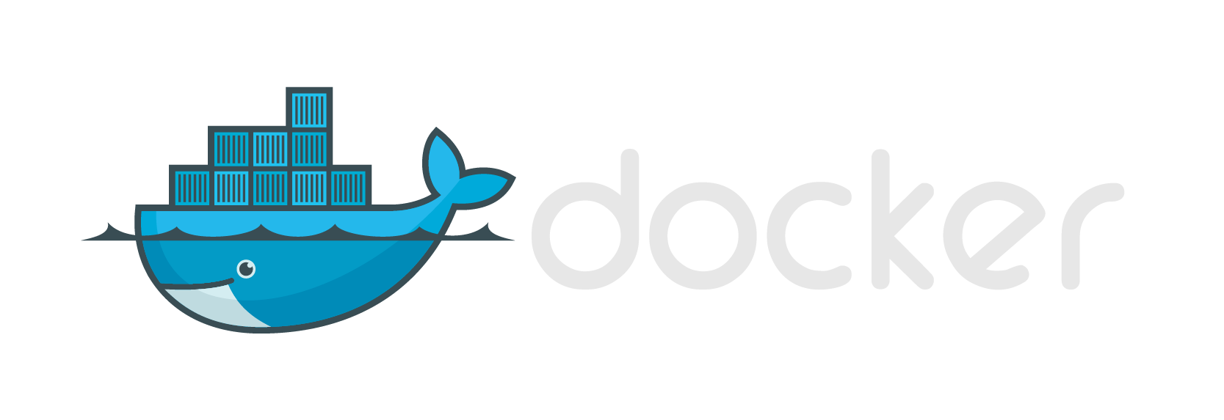




Modern App Dev, Flexible Isolation
Windows Container Images
Container Run-Times
Container Management
Docker
Hyper-V Container
PowerShell
Application
Framework
Others
Windows Server Container
Write once, deploy anywhere

Slide 48
Container Run-time
Windows Server Containers
Host Operating System

Slide 49
Container Run-time
Windows Server Container(s)
Hyper-V Container(s)
Host Operating System
Virtual machine(s)
Hyper-V Hypervisor

Slide 50
Container Run-time
Windows Server Container(s)
Hyper-V Container(s)
Hyper-V Hypervisor
Host Operating System
Virtual machine(s)
Hyper-V Hypervisor

Slide 51
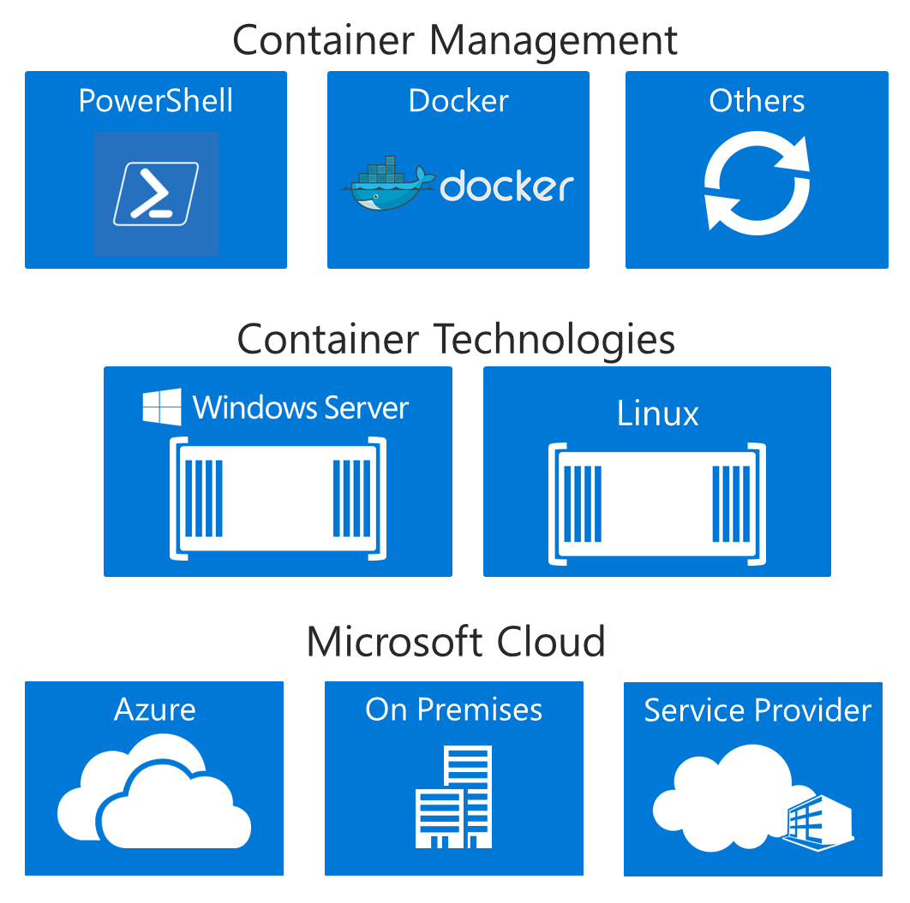
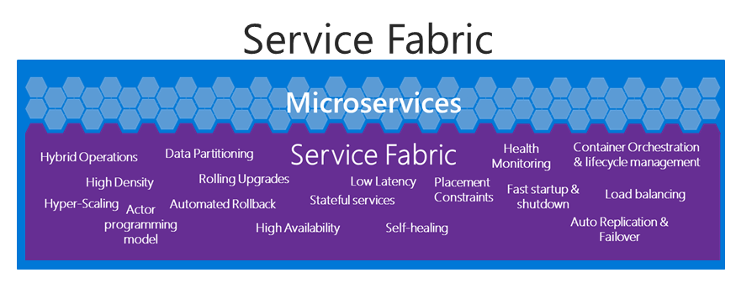
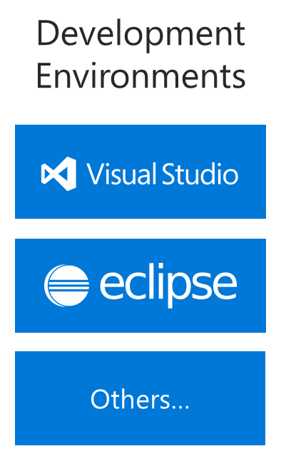
The right tools for you.

Slide 52
Labs
Windows Server 2016 TP5 installed
Minimum - 4GB de RAM
Recommended: virtualization supported (Intel-VT or AMD-V)
If you don´t have machines with WS2016 then use the following script (JSON) to provision VMs on Azure (all VMs are ready for labs)
WS2016 TP5 w/ Docker Client/Daemon installed and images w/ WindowsServerCore and NanoServer
https://raw.githubusercontent.com/Microsoft/Virtualization-Documentation/master/windows-server-container-tools/containers-azure-template/azuredeploy.json

Slide 53
Labs
Conexion with Internet (avoid proxy)
Some labs require partnership
Tips for pratical activities:
Powershell is not case-sensitive
Docker is case sensitive
Atenttion: The download of the images require time and bandwith. Please download all the images before:
Find-ContainerImage
Save-ContainerImage -Name NanoServer -Path c:\container-image

Slide 54
Lab 1
Installing Containers

Slide 55
Installing the container service
Open PowerShell in administrative mode
Install Container Service
Install-windowsfeature containers
Restart server
Restart-Computer –force

Slide 56
Install Docker
Open PowerShell in administrative mode
Create directory for Docker
New-item –type directory –path “c:\program files\docker\”
Download Docker Daemon
Invoke-WebRequest https://aka.ms/tp5/b/dockerd -OutFile $env:ProgramFiles\docker\dockerd.exe -UseBasicParsing
Download Docker Client
Invoke-WebRequest https://aka.ms/tp5/b/docker -OutFile $env:ProgramFiles\docker\docker.exe –UseBasicParsing
Create environament variable for Docker
[Environment]::SetEnvironmentVariable("Path", $env:Path + ";C:\Program Files\Docker", [EnvironmentVariableTarget]::Machine)
Register service
dockerd --register-service
Start service
Start-Service docker

Slide 57
Optional – update modules
Update container modules for PowerShell
http://github.com/microsoft/Docker-PowerShell
Register-PSRepository -Name DockerPS-Dev -SourceLocation https://ci.appveyor.com/nuget/docker-powershell-dev
Install-Module Docker -Repository DockerPS-Dev
Update-Module Docker

Slide 58
Install base images
Open PowerShell in administrative mode
Install package provider
Install-PackageProvider ContainerImage –Force
Method 1 – downalod and install images via Internet
Install-ContainerImage -Name WindowsServerCore
Install-ContainerImage -Name NanoServer
Method 2 – download and install later
Find-ContainerImage
Save-ContainerImage -Name NanoServer -Path c:\container-image
Install-ContainerOSImage -WimPath C:\container-image\NanoServer.wim –Force
Restart Docker after image installation
Restart-Service docker

Slide 59
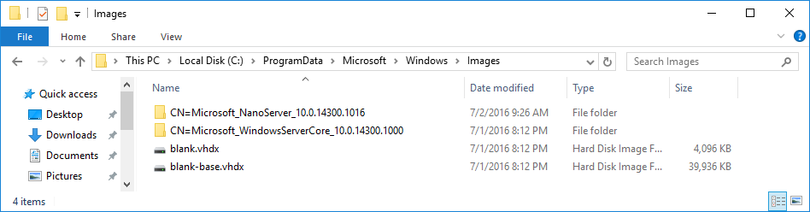
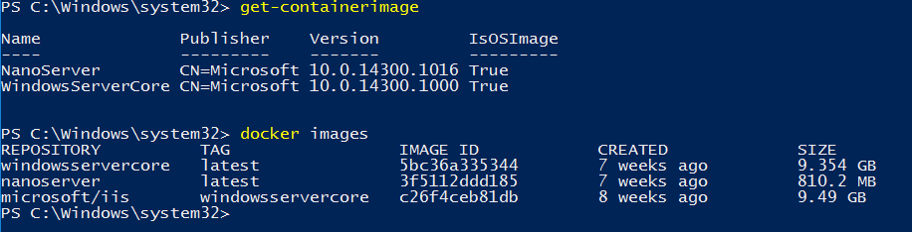
Verify installed images
Open Explorer
C:\ProgramData\Microsoft\Windows\images
Visualize using PowerShell or Docker

Slide 60
Prepare images
Add TAG for image to be used
docker tag windowsservercore:10.0.14300.1000 windowsservercore:latest
docker tag windowsservercore:10.0.14300.1016 nanoserver:latest
Visualize existent images
Docker images
Get-containerimage

Slide 61
Deploy Containers
Open PowerShell in administrative mode
Docker search Microsoft
OR
Docker search *
Downloading container
docker pull microsoft/iis:windowsservercore
Start container in background (-d), map port to host and container (-p) and execute PING to remain the container running
docker run -d -p 80:80 microsoft/iis:windowsservercore ping -t localhost
Visualize container in execution (ps)
Docker ps

Slide 62
Visualize Web Site
Verify wich IP Address used by host
Ipconfig
Use another computer on your network e type the IP Address on browser (step 1)

Slide 63
Shutdown container
Visualize container in execution and record the name
Docker ps
Remove container (rm) forcibly (-f)
Docker rm –f fervent_wright
Visualize active containers
Docker ps

Slide 64
Execute containers “on demand”
Open PowerShell in Administrative Mode
Start container in interactive mode (-it), map host port to container (-p) and visualize the command
docker run -it -p 80:80 microsoft/iis:windowsservercore ping -t localhost
Open another PowerShell in Administrative Mode and visualize containers
Docker ps
Return to the 1st PowerShell window (w/ PING command) and shutdown the container
CTRL + C
Return to the 2nd PowerShell window (w/ Docker PS command) and execute again

Slide 65
Edit content inside the container
Open PowerShell in administrative mode
Create new container and execute CMD
docker run -it -p 80:80 microsoft/iis:windowsservercore cmd
Delete default page from IIS
del C:\inetpub\wwwroot\iisstart.htm
Create new page
echo “Teste do @fabiohara" > C:\inetpub\wwwroot\index.html
Closing container session
Exit

Slide 66
Edit content inside the container (cont...)
Verify the name of the container
Docker ps –a
Create new container image (commit)
Docker commit nome_container modificado-iis
Visualize images created
Docker images

Slide 67
Optional Lab
Dockerfile

Slide 68
Sintax (example)
Iinform the container image to be used
FROM windowsservercore
Execute command (exec form or shell form)
RUN [“powershell”, “New-item”, “c:\\teste”]
OR
RUN powershell new-item c:\teste
RUN dism.exe /online /enable-feature /all /featurename:iis-webserver /norestart
RUN powershell.exe –command c:\vcredist_x86.exe /quiet
Copy data
COPY teste1.txt c:/temp/
COPY diretorio1 /sqldemo/
ADD (similar to COPY)
ADD teste2.txt c:/temp/
ADD https://www.python.org/ftp/python/3.5.1/python-3.5.1.exe /temp/python-3.5.1.exe

Slide 69
Sintax (example)(cont...)
Work directory
WORKDIR c:\\windows
WORKDIR c:\\app1\\dev
Default command to be executed during deployment of the container (exec form OR shell form)
CMD [“c:\\app1\\dev\\httpd.exe”, “-x”]
OR
CMD c:\\app1\\dev\\httpd.exe –x

Slide 70
Sintax (examples)(cont...)
Command lines to be executed via ESCAPE (character \ or `)
RUN powershell.exe -Command \
$ErrorActionPreference = 'Stop'; \
wget https://www.python.org/ftp/python/3.5.1/python-3.5.1.exe -OutFile c:\python-3.5.1.exe ; \
Start-Process c:\python-3.5.1.exe -ArgumentList '/quiet InstallAllUsers=1 PrependPath=1' -Wait ; \
Remove-Item c:\python-3.5.1.exe -Force
Using character `
FROM windowsservercore
RUN powershell.exe -Command `
$ErrorActionPreference = 'Stop'; `
wget https://www.python.org/ftp/python/3.5.1/python-3.5.1.exe -OutFile c:\python-3.5.1.exe ; `
Start-Process c:\python-3.5.1.exe -ArgumentList '/quiet InstallAllUsers=1 PrependPath=1' -Wait ; `
Remove-Item c:\python-3.5.1.exe -Force

Slide 71
Sintax (examples)(cont...)
PowerShell commands on Dockerfile
FROM windowsservercore
RUN powershell -command Expand-Archive -Path c:\apache.zip -DestinationPath c:\
REST Call
FROM windowsservercore
RUN powershell.exe -Command \
$ErrorActionPreference = 'Stop'; \
Invoke-WebRequest https://www.python.org/ftp/python/3.5.1/python-3.5.1.exe -OutFile c:\python\python-3.5.1.exe ; \
Start-Process c:\python\python-3.5.1.exe -ArgumentList '/quiet InstallAllUsers=1 PrependPath=1' -Wait ; \
Remove-Item c:\python\python-3.5.1.exe -Force

Slide 72
Sintax (examples)(cont...)
Invoke-webrequest and WebClient are not yet supported - Nano Server (TP5)
PowerShell command on Dockerfile
FROM windowsservercore
RUN powershell -command Expand-Archive -Path c:\apache.zip -DestinationPath c:\
REST call (using invoke-webrequest)
FROM windowsservercore
RUN powershell.exe -Command \
$ErrorActionPreference = 'Stop'; \
Invoke-WebRequest https://www.python.org/ftp/python/3.5.1/python-3.5.1.exe -OutFile c:\python\python-3.5.1.exe ; \
Start-Process c:\python\python-3.5.1.exe -ArgumentList '/quiet InstallAllUsers=1 PrependPath=1' -Wait ; \
Remove-Item c:\python\python-3.5.1.exe –Force
REST call (using .Net library - WebClient)
FROM windowsservercore
RUN powershell.exe -Command \
$ErrorActionPreference = 'Stop'; \
(New-Object System.Net.WebClient).DownloadFile('https://www.python.org/ftp/python/3.5.1/python-3.5.1.exe','c:\python\python-3.5.1.exe') ; \
Start-Process c:\python\python-3.5.1.exe -ArgumentList '/quiet InstallAllUsers=1 PrependPath=1' -Wait ; \
Remove-Item c:\python\python-3.5.1.exe -Force

Slide 73
Sintax (examples)(cont...)
PowerShell script on Dockerfile
FROM windowsservercore
ADD script.ps1 /windows/temp/script.ps1
RUN powershell.exe -executionpolicy bypass c:\windows\temp\script.ps1

Slide 74
Creating images via Dockerfile
Create directory to store Dockerfile
Powershell new-item c:\build\dockerfile –force
Edit Dockerfile with Notepad
Notepad c:\build\dockerfile
Create new image (using microsoft/iis:windowsservercore) and execute command
Copy and paste the following text
FROM microsoft/iis:windowsservercore
RUN echo "Hello World – teste de Dockerfile" > c:\inetpub\wwwroot\index.html
Save and close notepad
Create new image from Dockerfile
CD build
Docker build –t teste2 .
OR
Docker build –t iis-dockerfile c:\build

Slide 75
Creating images via Dockerfile (cont...)
Visualize available images
Docker images
Vsualize image dependency
Docker history name_image
Deploy new container based on image
docker run -d -p 80:80 iis-dockerfile ping -t localhost
Test: verify the host IP and open browser in another machine using this IP
Verify the name of the container in execution
Docker ps
Remove container (rm)
Docker rm –f nome_container
Extra: remove image (rmi)
Docker rmi –f id_do_container

Slide 76
Lab 2
Installing images via Docker Hub

Slide 77
Downloading images from Docker Hub
Open PowerShell in administrative mode and list available images
Find-containerimage
List images from Docker Hub
Docker search *
Download image with Apache for Windows Server Core
Docker pull microsoft/sample-httpd:windowsservercore
Download image with Apache for Nano Server
Docker pull microsoft/sample-httpd:nanoserver
List local images
Docker images

Slide 78
Optional Lab
Using VM as container Host

Slide 79
Enable Hyper-V Container in Hyper-V VM
Install VM with Windows Server 2016 TP5 and shutdown
Execute the following commands (Host)
#Name of the VM
$vm = "<virtual-machine>"
#configure the virtual processor
Set-VMProcessor -VMName $vm -ExposeVirtualizationExtensions $true -Count 2
#disable dynamic memory
Set-VMMemory $vm -DynamicMemoryEnabled $false
#enable mac spoofing
Get-VMNetworkAdapter -VMName $vm | Set-VMNetworkAdapter -MacAddressSpoofing On

Slide 80
Lab 3
Deploy Windows Containers and Hyper-V Containers

Slide 81
Prepare the Host
Verify if the host support virtualization
Mínimum 4GB RAM for labs
Windows Server 2016 TP5 or Windows 10 build 10565 (or superior)
Processor supporting Intel-VT or AMD-V
Msinfo32 to verify the processor support virtualization
Install Hyper-V role
Install-windowsfeature hyper-v
Restart server
Restart-computer -force

Slide 82
(Optional) Enable Hyper-V Container inside Hyper-V VM
Install the VM with Windows Server 2016 TP5 and shutdown
Execute the following commands (Host)
#name of the VM
$vm = "<virtual-machine>"
#configure virtual processor
Set-VMProcessor -VMName $vm -ExposeVirtualizationExtensions $true -Count 2
#disable dynamic memory
Set-VMMemory $vm -DynamicMemoryEnabled $false
#enable mac spoofing
Get-VMNetworkAdapter -VMName $vm | Set-VMNetworkAdapter -MacAddressSpoofing On

Slide 83
Using Nano Server VM to host Containers
Copy ISSO file of Windows Server 2016 TP5 locally and mount volume
Double click on ISSO file and access the directory \NanoServer
Copy the directory NanoServerImageGenerator to c:\Nano
Importe module
Import-module .\NanoServerImageGenerator -verbose
Open PowerShell in administrative mode and create Nano Server image
New-NanoServerImage -Edition Standard -DeploymentType Guest -MediaPath e:\ -TargetPath .\Nano\Nano.vhd -ComputerName Nano -containers -storage

Slide 84
Create Hyper-V VM for Nano
Create directory to store the VM (eg: c:\VM\Nano)
Copy the file Nano.VHD and paste on c:\vm\nano
Create VM with the name Nano and using the existent VHD (Nano.VHD)

Slide 85
Create Hyper-V container
Isolated mode (do not execute)
Docker run –it --isolation=hyperv nanoserver cmd
Powershell prompt will open CMD
Regular mode
Docker run –d windowsservercore ping localhost –t
Copy ID
Visualize ping process via Docker
Docker top “ID_copy”
You can see the Process ID and the command (ping)
Visualize ping process via Windows
Get-process –name ping
You can see the same process ID above

Slide 86
Create Hyper-V container (cont...)
Start container in isolated mode
docker run -d --isolation=hyperv nanoserver ping -t localhost
Copy ID
Visualize ping process via Docker
Docker top “ID_copy”
Visualize process via Windows
Get-process –name ping
The process ID will not be shown in “docker top” command
Visualize the isolated container
Get-process –name vmwp or via Task Manager

Slide 87
Lab 4
Managing data

Slide 88
Create data volumes
Execute container and create volume
Docker run –it –v c:\new-data-volume windowsservercore cmd
Create file on c:\new-data-volume
Echo “teste de volume de dados” > c:\novo-volume-dados\testevolume1.txt
Dir
Exit
Visualize volume on c:\ProgramData\docker\volumes

Slide 89
Mount data volume
Create folder on Host and copy files
Create folder c:\origem
Copy small files and paste inside this folder
Execute container mounting existing data volume on Host (c:\origem) to inside this container (c:\destino)
Docker run –it –v c:\origem:c:\destino windowservercore cmd
Command Prompt will be open
Visualize content
Using Command Prompt: enter on this folder c:\destino and visualize content (DIR)

Slide 90
Mounting single file
Create folder and test file on host
New-item -type directory –path c:\origem2
Echo “test with single file1” > c:\origem2\teste1.txt
Echo “test with single file2” > c:\origem2\teste2.txt
Echo “test with single file3” > c:\origem2\teste3.txt
Execute container and map file
Docker run –it –v c:\origem2\teste1.txt windowsservercore cmd
Visualize the directory content inside the container
Cd origem2
Dir
Inspect shared volume
Docker inspect nome_container

Slide 91
Optional Lab
Managing resources

Slide 92
Managing resources
Controlling CPU resources (1-10000, default 5000) for 2 virtual processors
Docker run –it --cpu-shares 2 –name dockerdemo windowsservercore cmd
OBS: CPU and IO still not yet supported in Hyper-V Containers
IO still not yet supported using data volume

Slide 93
Optional Lab
Nano VM using Hyper-V containers
OBS: installing new images are still not available (TBD)

Slide 94
Optional –Nano VM with Hyper-V containers
Also know as Nested Virtualization
If you want to create hyper-v containers inside Nano VM just execute the following PowerShell script:
#name of the VM
$vm = "<virtual-machine>"
#configure the virtual processor
Set-VMProcessor -VMName $vm -ExposeVirtualizationExtensions $true -Count 2
#disable dynamic memory
Set-VMMemory $vm -DynamicMemoryEnabled $false
#enable mac spoofing
Get-VMNetworkAdapter -VMName $vm | Set-VMNetworkAdapter -MacAddressSpoofing On

Slide 95
Enabling Firewall rules on Nano Server
Logon on Nano Server console and access “Inbound Firewall Rules”
Enable each rule of “File and Printer Sharing”
Press F4 to enable
Status will be “Allow”
Optional – enable remote management via WinRM
Select option “Windows remote Management” e press ENTER twice
Verify the IP address used by Nano
Select “Networking” and select “Ethernet Adapter”

Slide 96
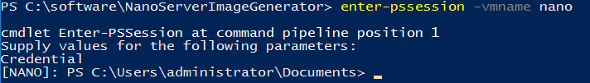
Install Docker on Nano Server VM
Nano Server TP5 not support Invoke-WebRequest
Download locally (eg: via Host) Docker Daemon and Client
Invoke-WebRequest https://aka.ms/tp5/b/dockerd -OutFile .\dockerd.exe
Invoke-WebRequest https://aka.ms/tp5/b/docker -OutFile .\docker.exe
Remote connect on Nano Server VM
Open PowerShell in administrative mode and type the following command:
Create folder C:\Docker, share and copy the content downloaded
New-item –type directory c:\docker
New-SmbShare –name DOCKER –path c:\docker
Grant-SmbShareAccess –name DOCKER –AccountName Administrators –AccessRight Full -force

Slide 97
Install Docker on Nano Server VM(cont..)
Register Docker Service on Windows
& “c:\docker\dockerd.exe” --register-service
Inicialize Docker service
Start-service docker
Install Package Provider for Windows Containers
Install-packageprovider ContainerImage –force –verbose
Download and install base image of Nano Server
Install-containerimage –name NanoServer –version 10.0.14300.1010
Obs: command is not yet available for Nano

Slide 98
Optional Lab
Configuring Docker

Slide 99
Configuring Docker on Windows
Daemon.json
C:\ProgramData\docker\config\daemon.json
If the file does not exist then you can create
Obs: not all parameters on daemon.json are valid on Docker for Windows
Enable connection to Docker daemon on TCP 2375
Option 1 – daemon.json
"hosts": ["tcp://0.0.0.0:2375", "npipe://"]
Option 2 – SC Config (via CMD.exe)
sc config docker binpath= "\"C:\docker\dockerd.exe\" --run-service -H tcp://0.0.0.0:2375"

Slide 100
Optional Lab
Remove Images

Slide 101
Remove installed images
Powershell
Uninstall-ContainerOSImage –fullname CN=Microsoft_NanoServer_10.0.14300.1016
Docker
Remove images
Docker rmi windowsservercoreiis
Remove containers
Docker rm

Slide 102
Important Links
Msdn.microsoft.com/virtualization/windowscontainers
Docs.docker.com
Azure.microsoft.com/en-us/blog/containers-docker-windows-and-trends
blogs.technet.microsoft.com/windowsserver/2015/10/28/a-closer-look-at-windows-server-and-hyper-v-containers-with-mark-russinovich/
Technet.microsoft.com/en-us/library/mt126167.aspx
mva.microsoft.com/pt-br/training-courses/docker-conceitos-e-prtica-12185
mva.microsoft.com/en-US/training-courses/whats-new-in-windows-server-2016-16457

Slide 103


© 2015 Microsoft Corporation. All rights reserved. Microsoft, Windows and other product names are or may be registered trademarks and/or trademarks in the U.S. and/or other countries.
The information herein is for informational purposes only and represents the current view of Microsoft Corporation as of the date of this presentation. Because Microsoft must respond to changing market conditions, it should not be interpreted to be a commitment on the part of Microsoft, and Microsoft cannot guarantee the accuracy of any information provided after the date of this presentation. MICROSOFT MAKES NO WARRANTIES, EXPRESS, IMPLIED OR STATUTORY, AS TO THE INFORMATION IN THIS PRESENTATION.

